Slide 1
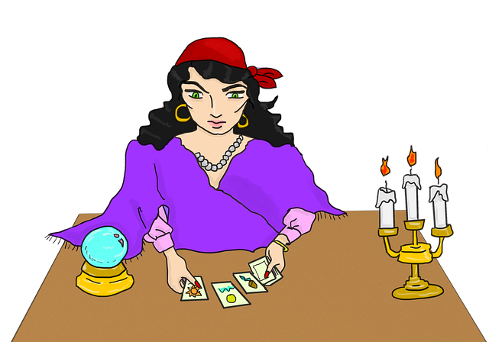
Talking about future WILL
Όνομα Εκπαιδευτικού
Σχολείο

Slide 2
WILL {use}
I will help you do the dishes.
I promise I won’t hurt her.
Don’t do that or I’ll tell mum!
I’ll take my hat with me, it’s so hot outside!
I think Barcelona will lose the game.
OFFER
PROMISES
THREAT
REQUEST
ON-THE-SPOT DECISION
PREDICTION

Slide 3
WILL {form}
AFFIRMATIVE | INTERROGATIVE
I/you/he/etc. will fix the car. | Will I/you/he/etc. fix the car?
NEGATIVE | SHORT ANSWERS
I/you/he/etc. will not fix your car. | Yes, I/you/he/etc. will fix your car.
won't | No, I/you/he/ etc won't fix your car.

Slide 4
Key words!!
I promise
I believe
I think
I hope
I bet
Perhaps
Probably
Be afraid

Slide 5
REMEMBER!!
WE DO NOT USE WILL FOR PLANS!!

Slide 6
Talking about future Going to
Going to
plans
Prediction based on evidence

Slide 7
Subject+ BE + GOING + TO - infinitive
Plans/ intention
Prediction based on evidence
I’m going to buy a new laptop as a present for Joe’s birthday.
The sky is very black. It’s going to snow.

