Slide 1
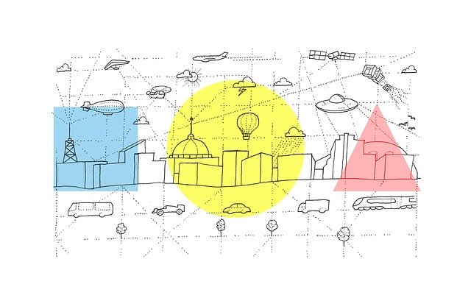
Transport through the ages
Όνομα Εκπαιδευτικού
Σχολείο

Slide 2
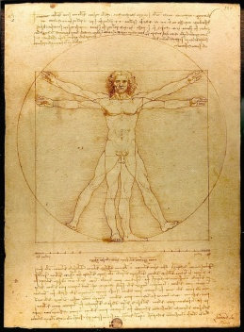
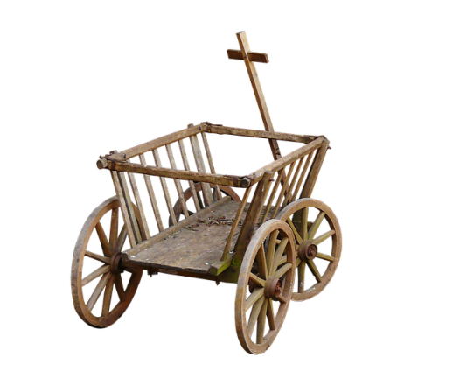
Historical timeline
3500 BC
Wheeled carts are invented
1492
Leonardo da Vinci designs a flying machine
1769
First self-propelled road vehicle invented by Nicolas Joseph Cugnot

Slide 3
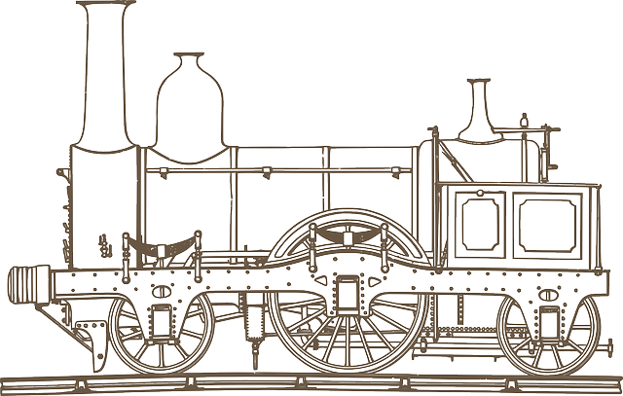
Historical timeline
1783
First hot air balloons and first practical steam paddle boat
1807
1814
First passenger tram -with open carriages
George Stephenson invents the first practical steam powered railroad locomotive

Slide 4
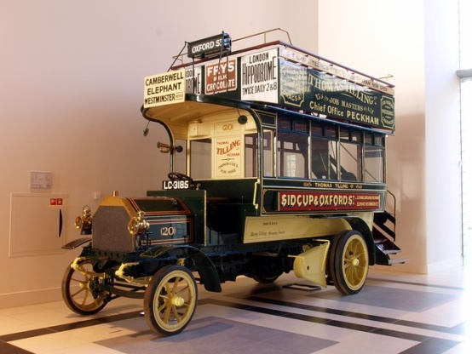
Historical timeline
1815
Steamships cross the English Channel
1829
1881
Horse drawn omnibuses first introduced in London
First electric tram in Germany

Slide 5
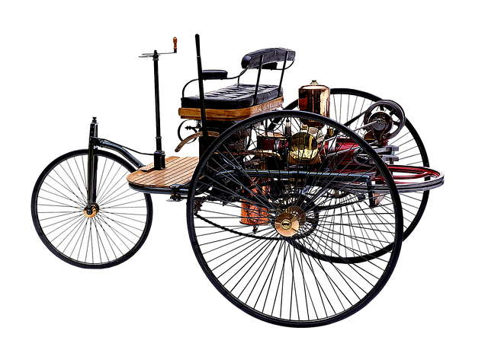
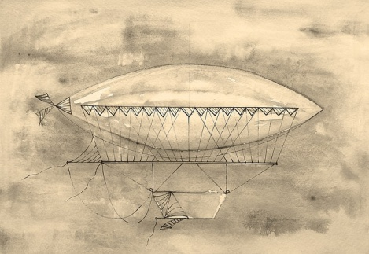
Historical timeline
1885
1889
1899
Karl Benz builds the world's first practical automobile to be powered by an internal combustion engine
Pneumatic rubber tyres invented
Ferdinand von Zeppelin invents the first successful airship-the Zeppelin

Slide 6
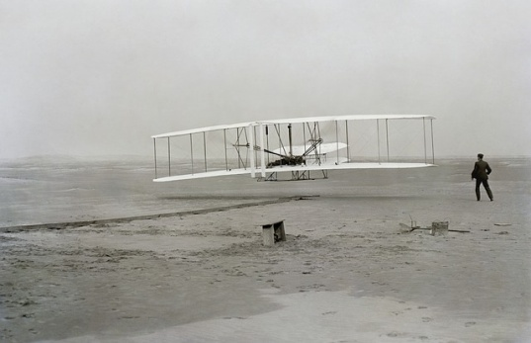
Historical timeline
1903
The Wright Brothers invent and fly the first engined airplane
1919
1930s
Planes begin carrying passengers between London and Paris
In most towns electric trams are replaced by buses

