Slide 1


Giving directions
Όνομα Εκπαιδευτικού
Σχολείο

Slide 2

Questions you can ask about directions
Can you please tell me how I can get to …?
Where is the nearest …?
How can I get to …?
I'm trying to get to … Street.
How do I get to …?
What's the best way to … ?
Where is …can you tell me please?

Slide 3

How to give directions to somebody else
Go straight on till you see the… then turn left.
Turn back, you have gone past the turning.
Turn left when you see a roundabout.
Turn right at the end of the road.
Cross the junction and keep going for about 1 mile.
Take the third road on the right and you will see the … on the right
Take the third road on the right and you will see the … on the left
Take the second road on the left and you will see the…straight ahead

Slide 4

Prepositions + useful vocabulary
Opposite
Near
next to
Between
At the end of
On the left/right
Right across
Go straight
Roundabout
Crossroad
Signpost
Traffic lights

Slide 5
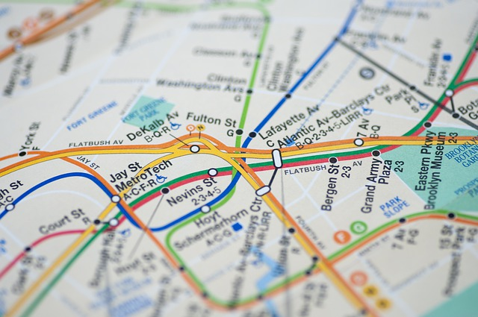
PRACTICE

