Slide 1
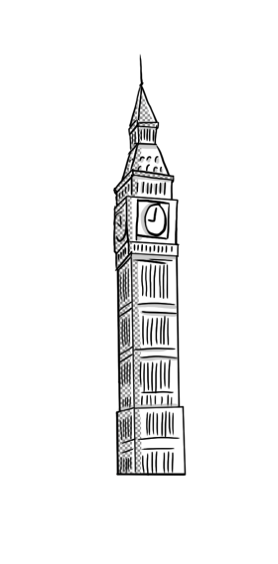
Used to
Όνομα Εκπαιδευτικού
Σχολείο

Slide 2
Subject+ used to +infinitive
Affirmative
I used to play the piano √
Interrogative
Did you use to play the piano?
Negative
I didn’t use to play the piano.

Slide 3
We treat used to as any other verb in past simple!! → we take out the ed
Use!

Slide 4
Use= happened regularly in the past
We use it for past states
I used to be stronger → but now I’m not
We use it for past habits
I used to eat unhealthy → but now I don’t
We use it with action (play, run, go) + non-action verbs (be, like, have)

Slide 5
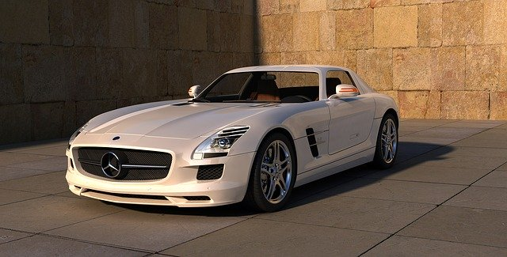
Used to
IN THE PAST
NOW
In the past people used to ride this kind of cars
But now we don’t. Instead we drive this kind of cars

