Slide 1
Γ9- My garden in the spring
Όνομα Εκπαιδευτικού
Σχολείο

Slide 2
It’s sunny!

Slide 3
It’s cloudy

Slide 4
It’s raining

Slide 5
It’s windy!

Slide 6
Listen! What can you hear?
https://www.youtube.com/watch?v=qz54e2LWonM

Slide 7
Look! What can you see?

Slide 8
Winter

Slide 9
Spring

Slide 10
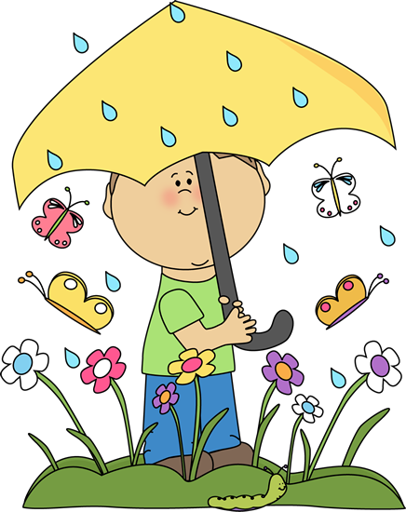
How’s the weather?

Slide 11
How’s the weather?

Slide 12
Look!

Slide 13
Look!

Slide 14
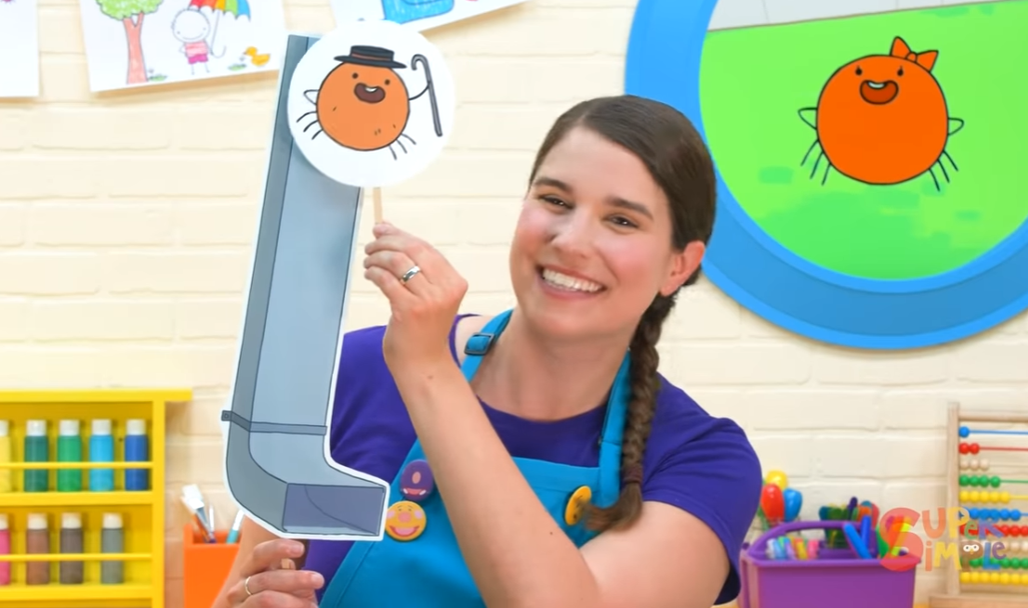
The Itsy Bitsy Spider
https://www.youtube.com/watch?v=1MXzCD8IAcE&t=70s

Slide 15
Spring
https://www.youtube.com/watch?v=J7lf8i6qhdM

Slide 16
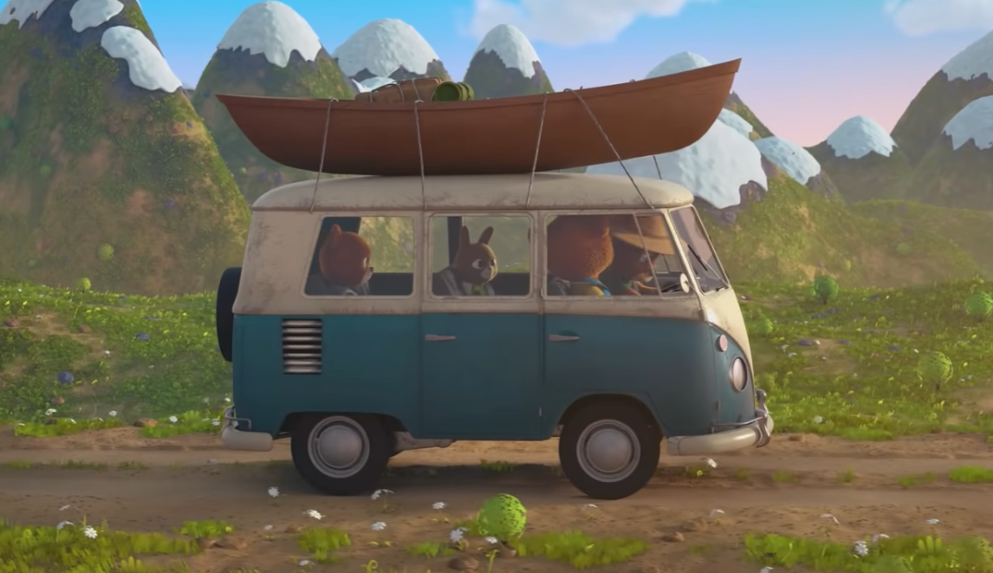
I love the mountains
https://www.youtube.com/watch?v=mmjbF3A30eQ

Slide 17
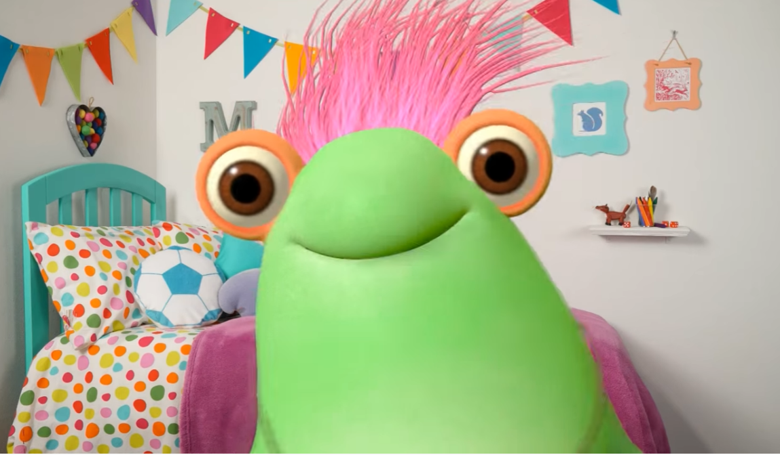
Color Me Spring Song
https://www.youtube.com/watch?v=-E5A_uZjhsw&t=14s

Slide 18
Mr. Sun, Sun, Mr. Golden Sun
https://www.youtube.com/watch?v=hlzvrEfyL2Y

Slide 19
The Bees Go Buzzing
https://www.youtube.com/watch?v=bWUgZm_AE64

Slide 20
Here is the beehive
https://www.youtube.com/watch?v=V5Bs9xydba0

